Slide 1

NEON Remote Sensing Data
LeahAWasser
The National Ecological Observatory Network is a project sponsored by the National Science Foundation and managed under cooperative agreement by NEON Inc.

Slide 2
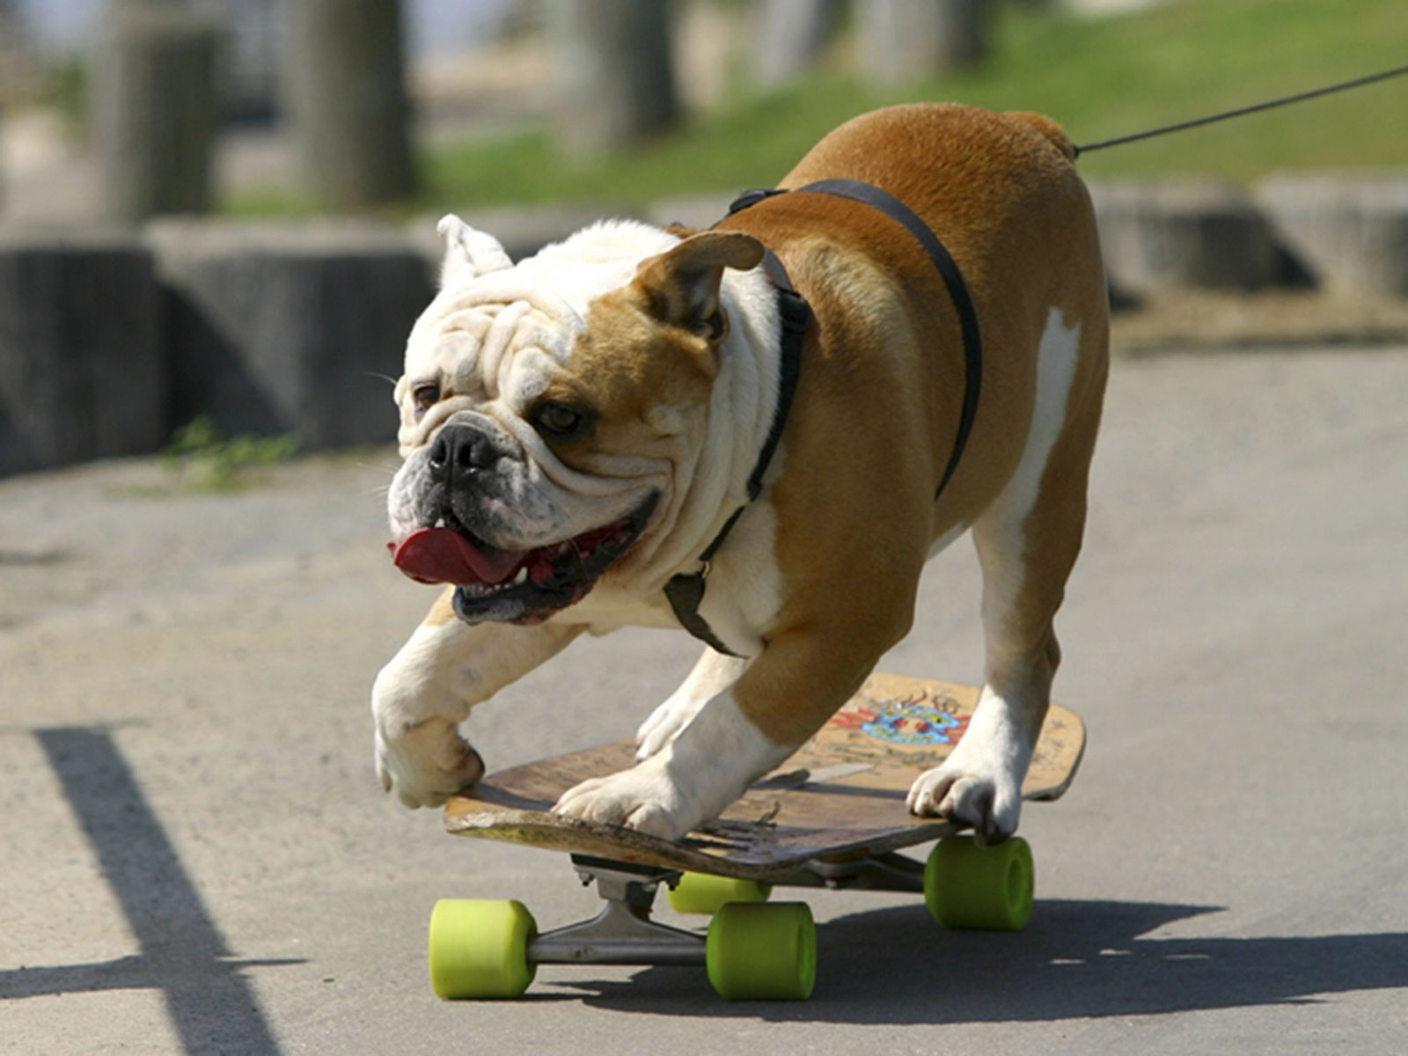
Notes:
You take a picture with your iphone of this… what is actually recorded?? Well.. The image is in color. It si called an RGB image because light is recorded in areas of the light spectrum that we can ssee
Red green blue. In the

Slide 3
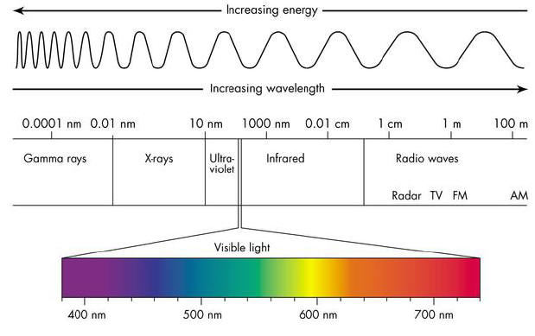
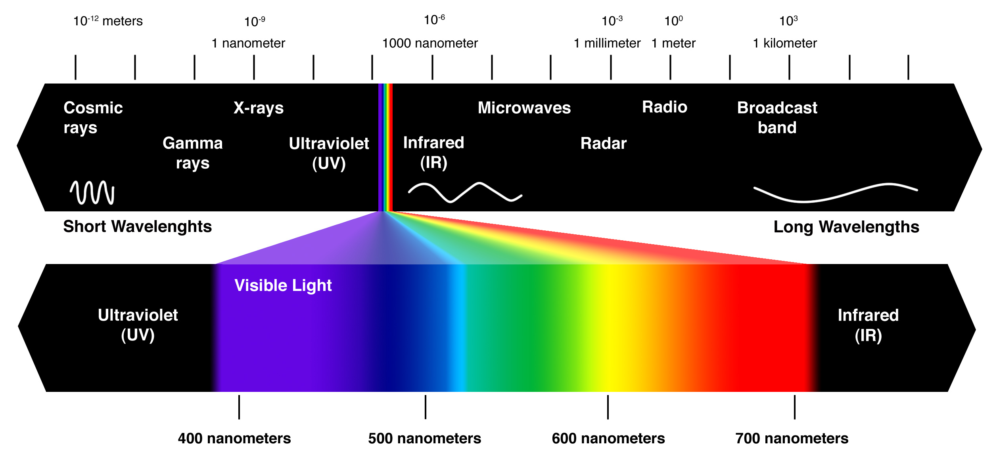

Slide 4
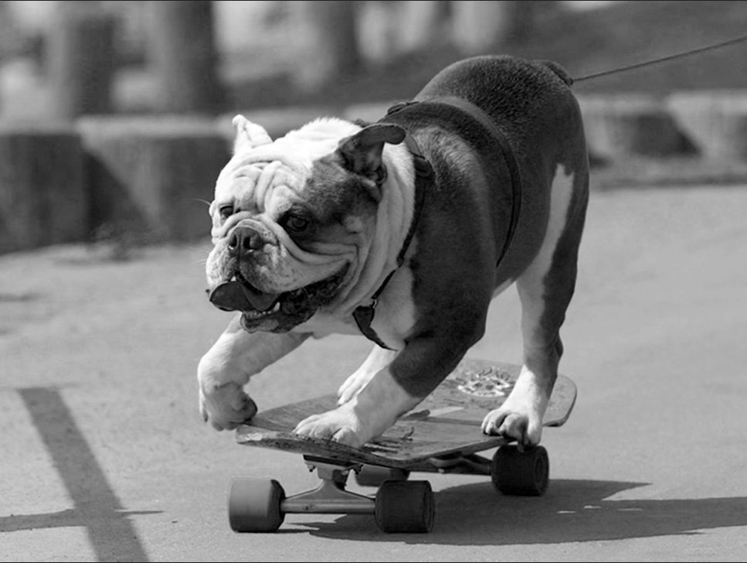
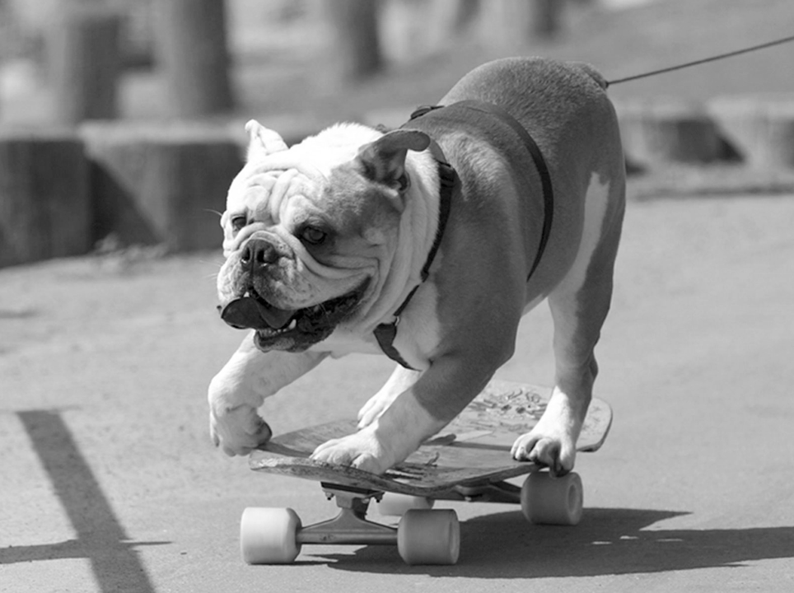
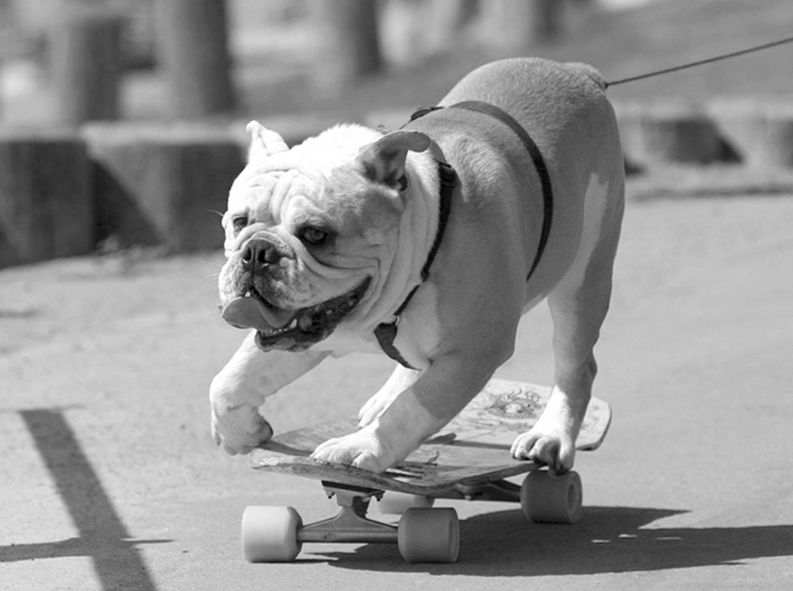
Blue Band
Green Band
Red Band
Notes:
You take a picture with your iphone of this… what is actually recorded?? Well.. The image is in color. It si called an RGB image because light is recorded in areas of the light spectrum that we can ssee
Red green blue. In the

Slide 5
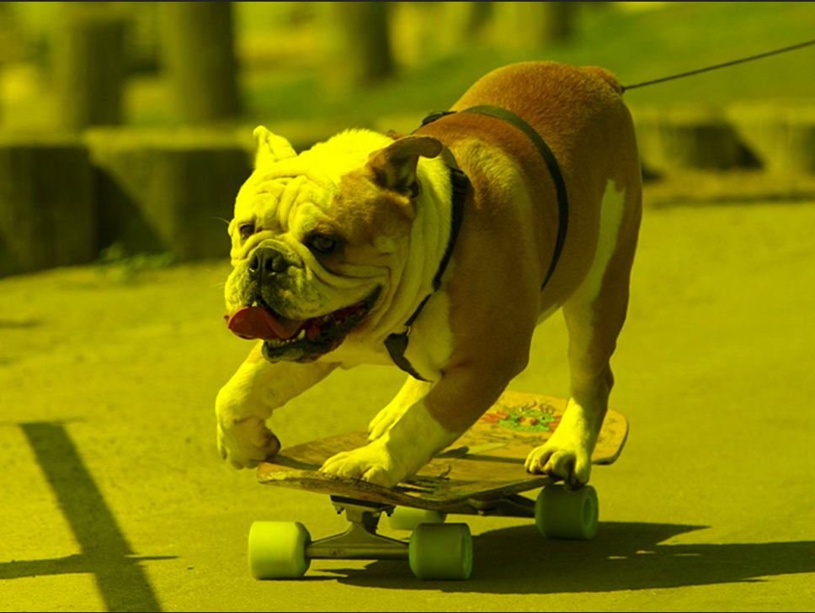
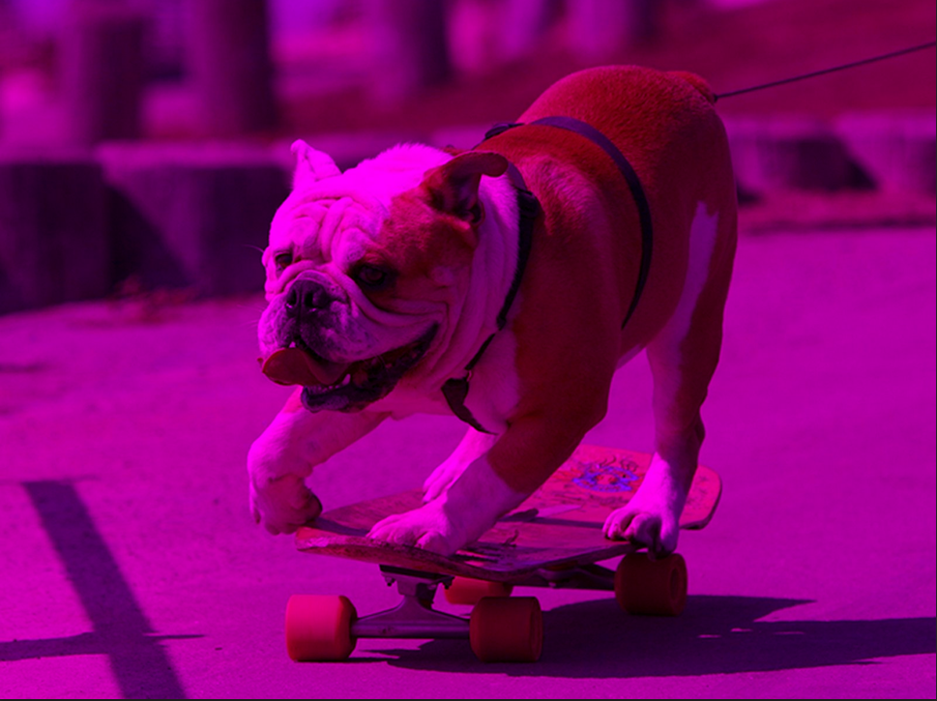
Blue + Green
Red + Blue = psychadelic bulldog

Slide 7
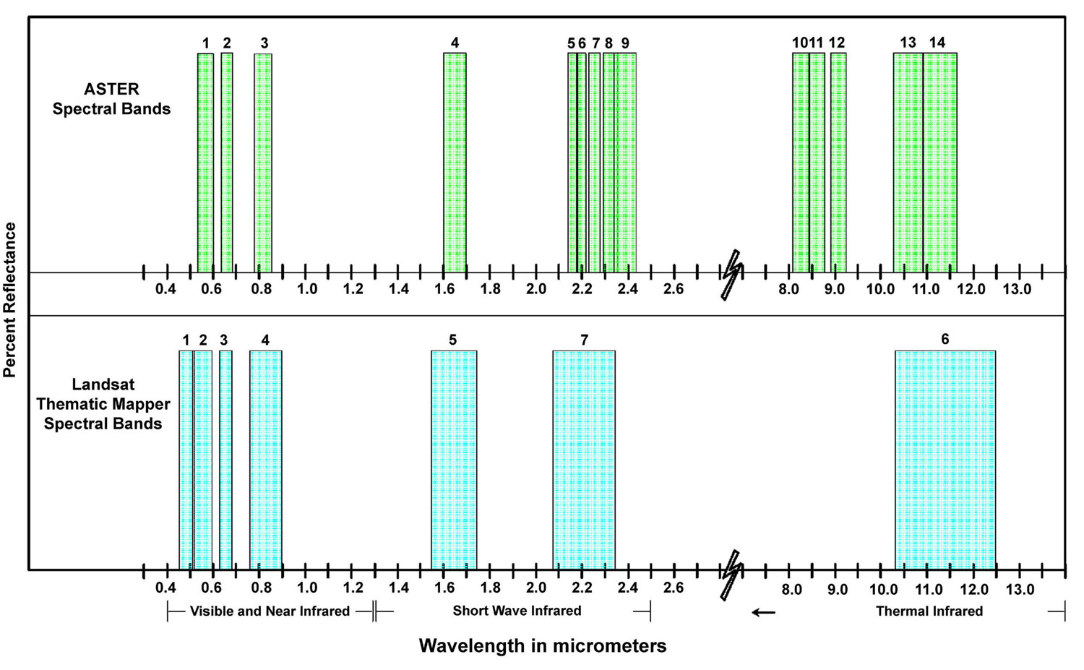
Notes:
You take a picture with your iphone of this… what is actually recorded?? Well.. The image is in color. It si called an RGB image because light is recorded in areas of the light spectrum that we can ssee
Red green blue. In the

Slide 8
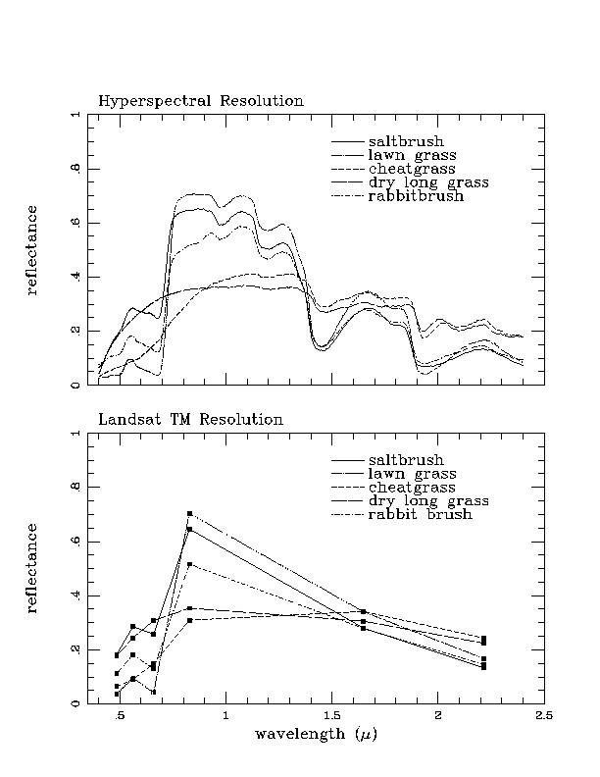
http://www.ece.rice.edu/~erzsebet/AVIRIS-TM-veg.html

Slide 9
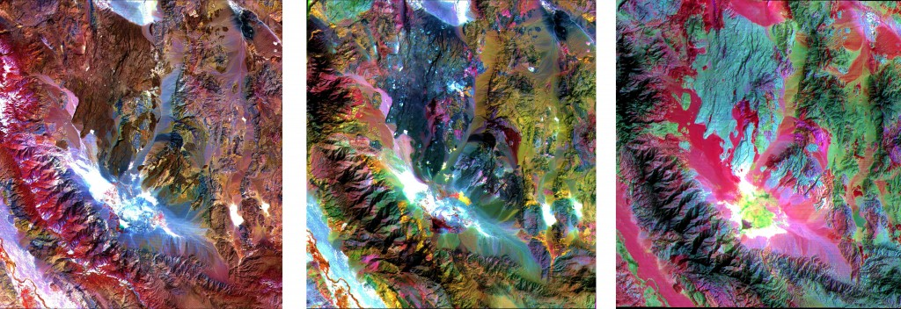
Notes:
http://auracle.ca/news/

Slide 10
Sample AOP Higher-Level Data Products
Data Product | Description
Leaf water content | Upper canopy water content measured as equivalent water thickness
Leaf nitrogen content | Upper canopy nitrogen content
Pigment concentrations | Vegetation indices sensitive to concentrations of chlorophyll, xanthophylls, caroteniod and anthocyanin
fPAR: Fraction of photosynthetic active radiation | Measure of available radiation in specific wavelengths absorbed by canopy
Albedo | The fraction of total incident radiation striking a surface that is reflected by that surface
LAI: Leaf area index | Measure of green area per unit ground surface area
Cover fraction | Relative amounts of photosynthetic and non-photosynthetic vegetation, including bark, litter, branches, etc.
GPP: Gross primary production | Measure of the rate at which an ecosystem's producers capture and store a given amount of chemical energy as biomass in a given length of time
Canopy height (LiDAR) | Horizontal distribution of height profile of canopy components measured as the distance the canopy top and ground
Canopy structure (LiDAR) | Position, extent, quantity, volume, and shape of aboveground vegetation in both vertical and horizontal directions
Surface roughness (LiDAR) | Calculated as the standard deviation of the measured canopy heights

Slide 11
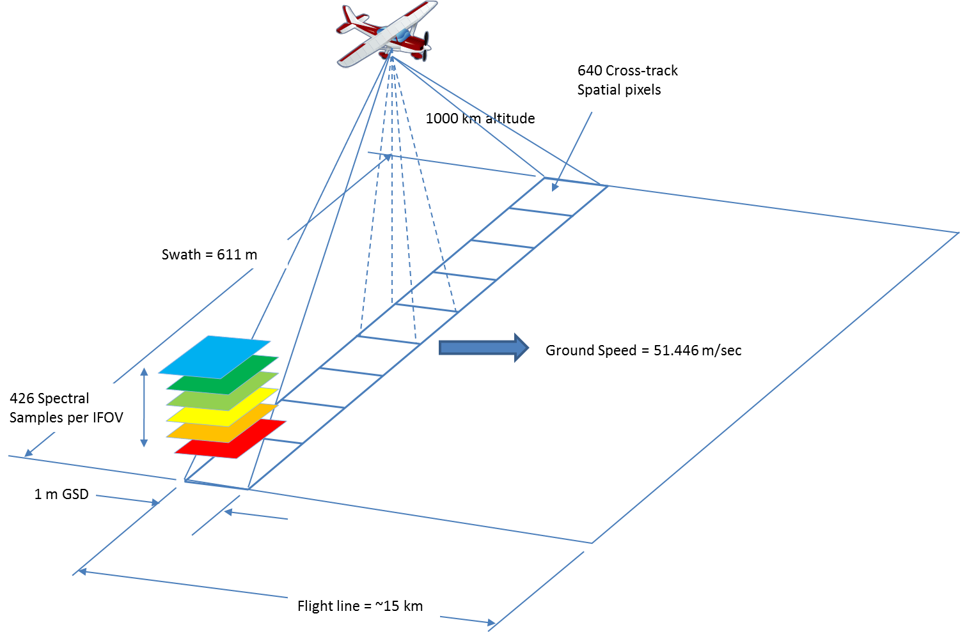
Hyperspectral Imaging
Notes:
Terrestrial Site
A minimum-area flight box of 10 km x 10 km (100,000,000m2) will be delineated over all terrestrial sites. The instrument tower should be located a minimum of 2 km from the edge of the flight box and as close to the center of the flight box as possible. The cumulative flux and concentration footprint within the tower airshed should be used to define the configuration of the flight box around the instrument tower. For larger sites with TOS field plot boundaries that exceed the 10 km x 10 km minimum flight area, the flight box will be expanded so that AOP data are collected over the entire TOS sampling area. The flight box may also be augmented to sample ecologically relevant areas adjacent to the TOS boundary for the purpose of supporting science questions related to scaling.
Aquatic Site
Flight plans for aquatic sites will be delineated to cover the watershed boundaries of each aquatic site, as designated by the Aquatics team. There is no minimum-area flight box associated with aquatic sites, though very large watersheds may need to be truncated when their extent exceeds 200km2.

Slide 12
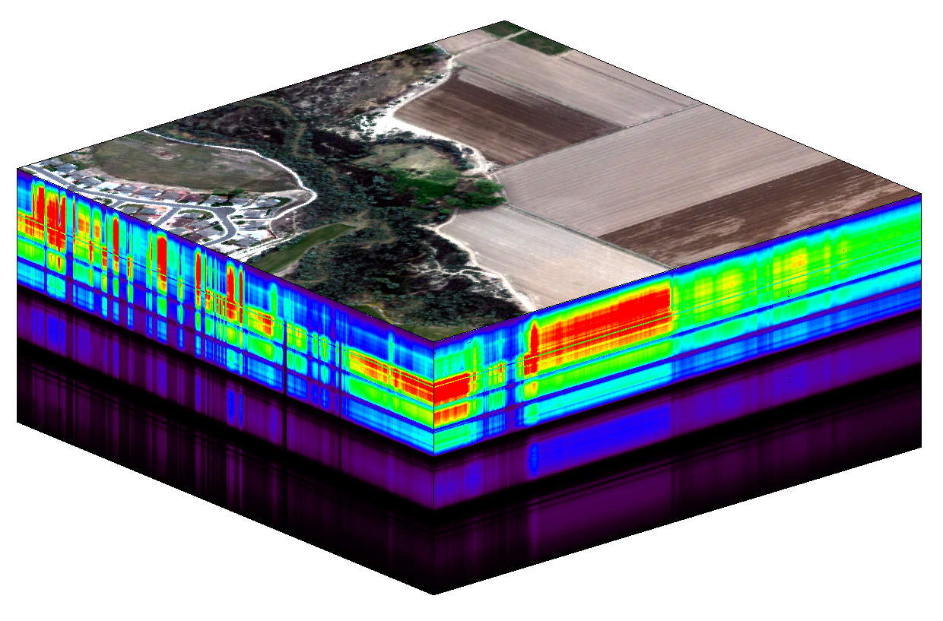
Z- Spectral Dimension (~5nm!!)
X – Spatial Dimension
Y – Spatial Dimension

Slide 13
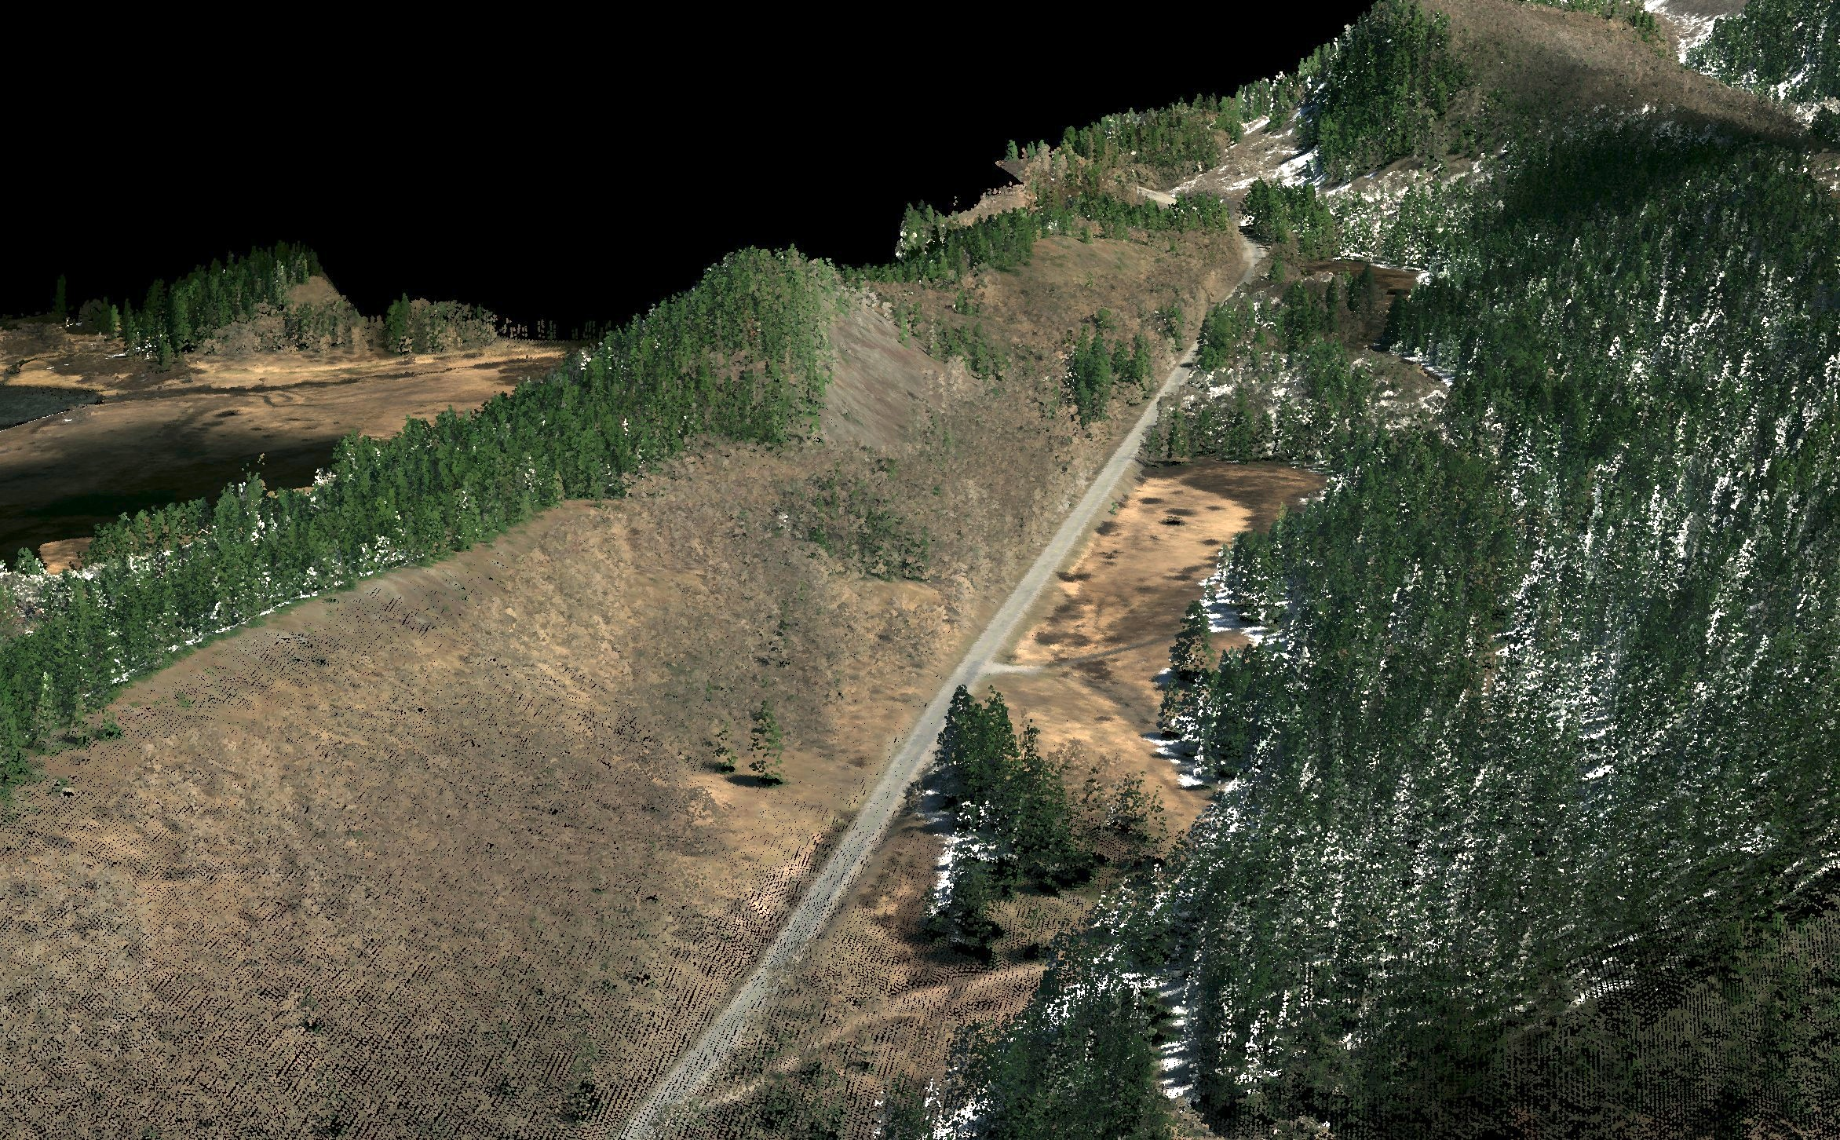
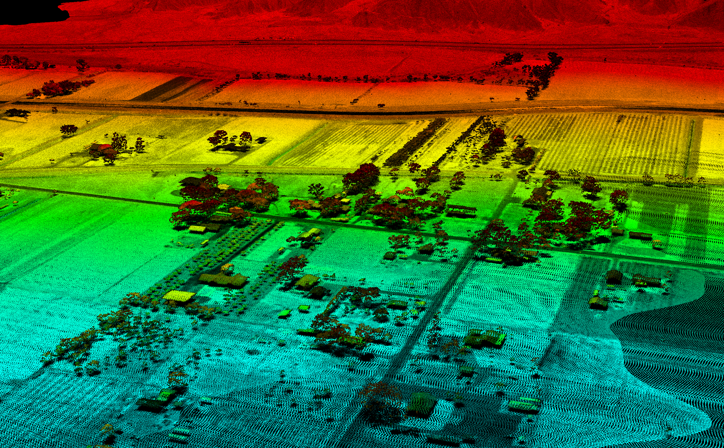
Aspen & Pine
Senescent Grass
Snow

Slide 14
Aspen & Pine
Note: Vegetation is highly reflective in the Near Infrared portion of the spectrum

Slide 15
Hierarchical Spectral Data
X,Y – individual pixels representing reflectance values for a band
Z – n dimensional array of matrices – each matrix in the array represents a band
Key Attributes
Spatial Resolution (pixel size) – how much area on the ground does each pixel represent
Spectral resolution – how much of the electromagnetic spectrum does each band represent
Projection & Coordinate System Information

Slide 16
Let’s Check out some Data
Time to rock out -- Open Up the HDFViewer…

Slide 17
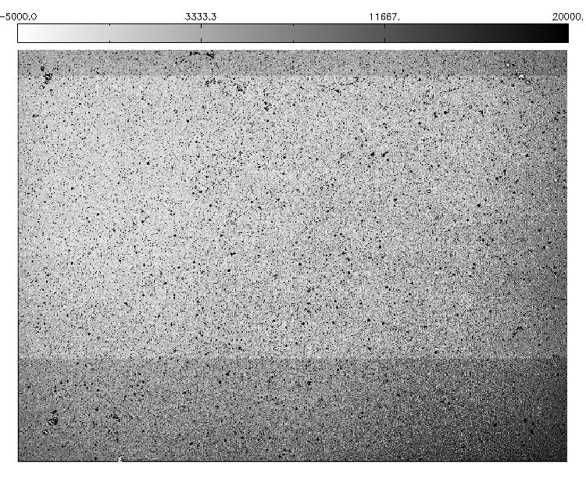
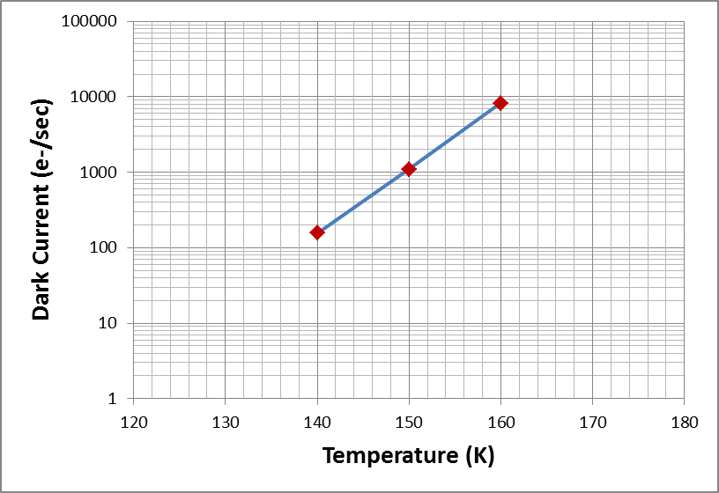
Why do We Cool the Spectrometer?
The principle sources of dark noise are temperature dependent and therefore dark current is reduced by cooling the FPA below ambient.
Nominally, the FPA and the entire instrument is cooled to ~140 K during operation. The actual temperature dependence is device specific.

Slide 18
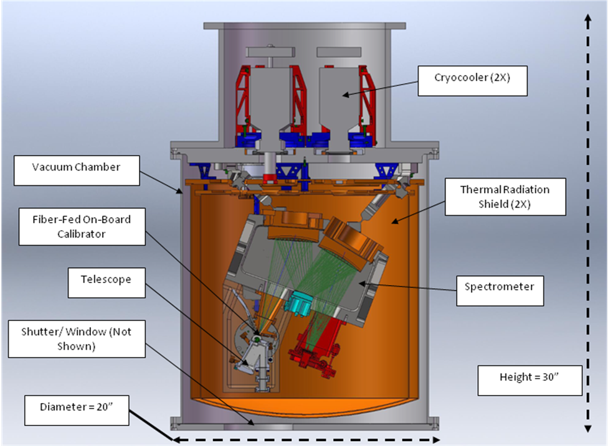
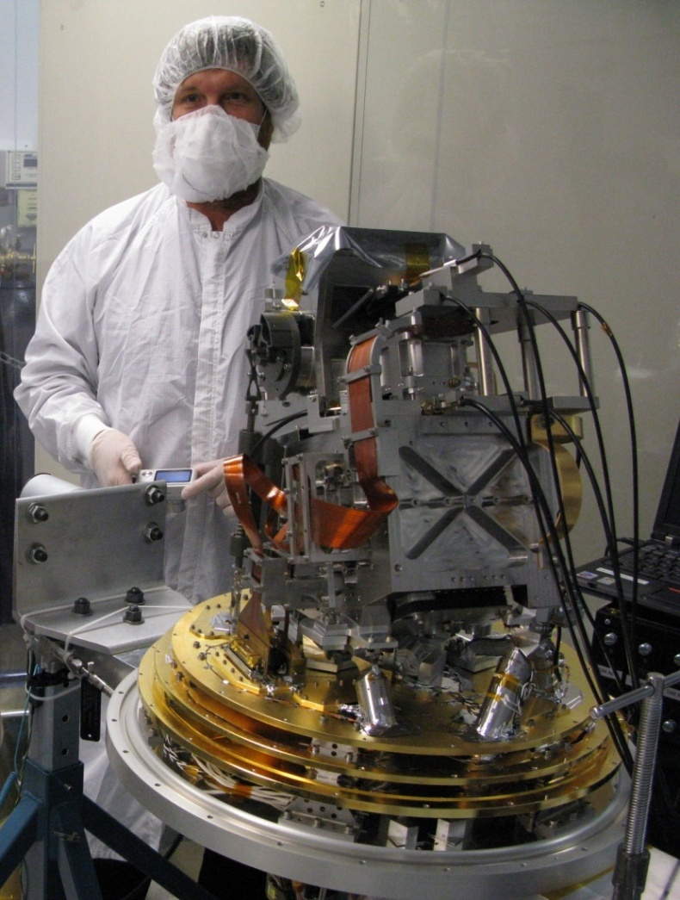
NEON Imaging Spectrometer

Slide 19
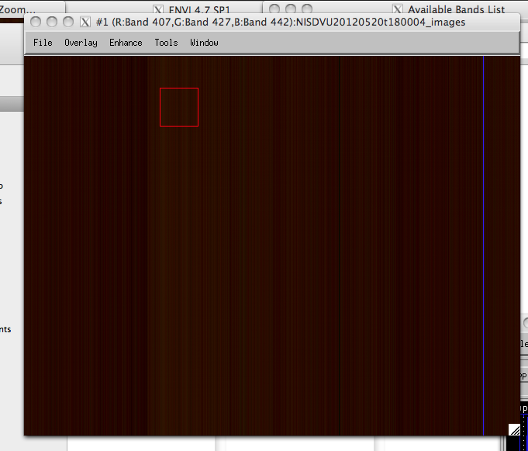
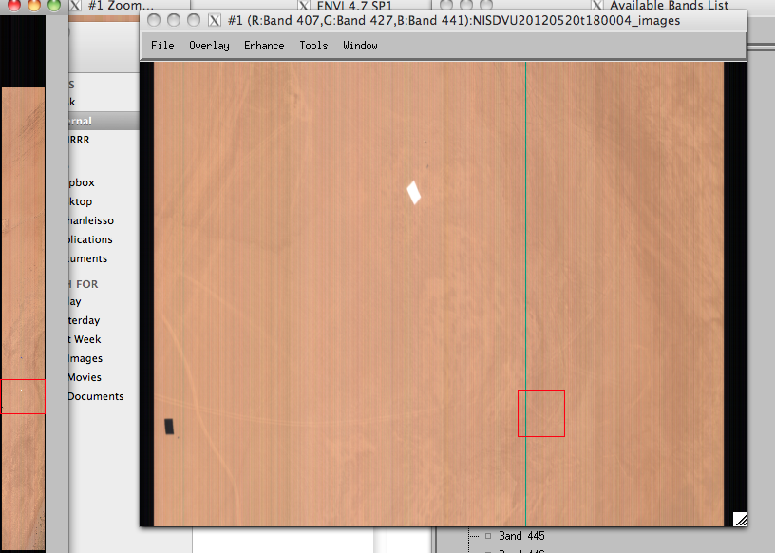
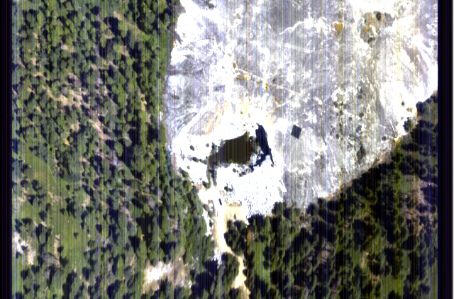
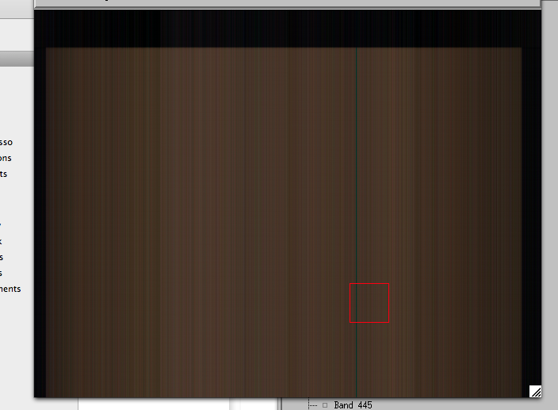
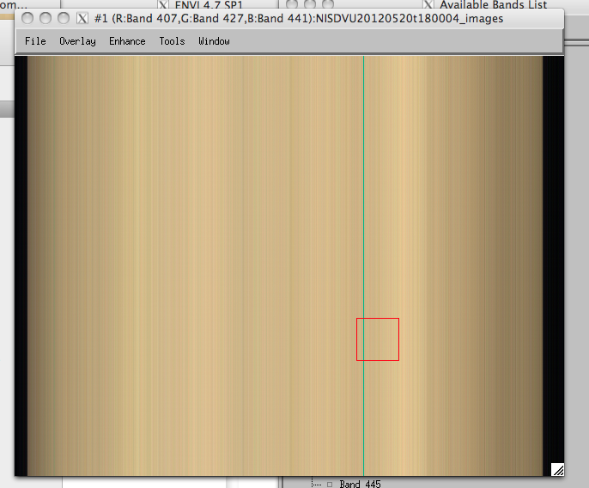
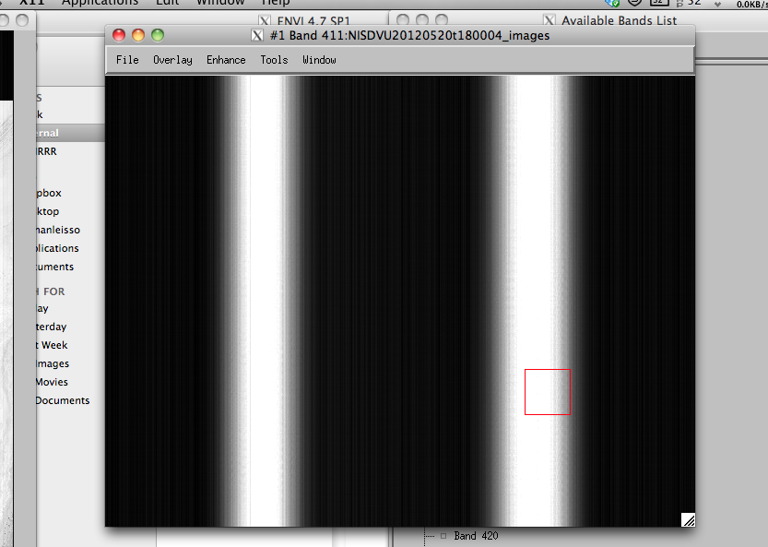
NIS Raw Flight Line Sequence
Dark Frame is taken prior to science collection
Science data is taken of the flight line target. In this case, Soaproot Saddle in NEON’s Domain 17 collected in 2013. Reflectance tarps are visible in the uncorrected image
Dark Frame is taken after science collection
On-board calibrator (OBC) data is taken at a low light level immediately after second dark collect.
On-board calibrator (OBC) data is taken at a higher light level to improve signal at short wavelengths.
Laser data is taken to provide a spectral check and to conclude the sequence.

Slide 20
Sample AOP Higher-Level Data Products
Data Product | Description
Leaf water content | Upper canopy water content measured as equivalent water thickness
Leaf nitrogen content | Upper canopy nitrogen content
Pigment concentrations | Vegetation indices sensitive to concentrations of chlorophyll, xanthophylls, caroteniod and anthocyanin
fPAR: Fraction of photosynthetic active radiation | Measure of available radiation in specific wavelengths absorbed by canopy
Albedo | The fraction of total incident radiation striking a surface that is reflected by that surface
LAI: Leaf area index | Measure of green area per unit ground surface area
Canopy height | Horizontal distribution of height profile of canopy components measured as the distance the canopy top and ground
Canopy structure | Position, extent, quantity, volume, and shape of aboveground vegetation in both vertical and horizontal directions
Surface roughness | Calculated as the standard deviation of the measured canopy heights
Cover fraction | Relative amounts of photosynthetic and non-photosynthetic vegetation, including bark, litter, branches, etc.
GPP: Gross primary production | Measure of the rate at which an ecosystem's producers capture and store a given amount of chemical energy as biomass in a given length of time

Slide 21

